Slide 1
Developing an Evasive C2 Agent
Dylan Reuter
Information Assurance Consultant
OSCP, eCPPTv2

Slide 2
About Me
2 years at SynerComm
Live in Austin, Texas
Former Software Engineer
Love malware development

Slide 3
What We’ll Cover
What is a C2?
Most common C2 communication channels
Basics of ICMP protocol
Why Rust?
Using Rust to implement a “ping”
EchoC2 demo

Slide 4

What is a C2?
Command and Control framework
Maintain control over compromised computer systems
Issue tasks to compromised machine to control it remotely
Can be used for data exfiltration, further malware deployment, or carrying out malicious actions on the compromised systems

Slide 5
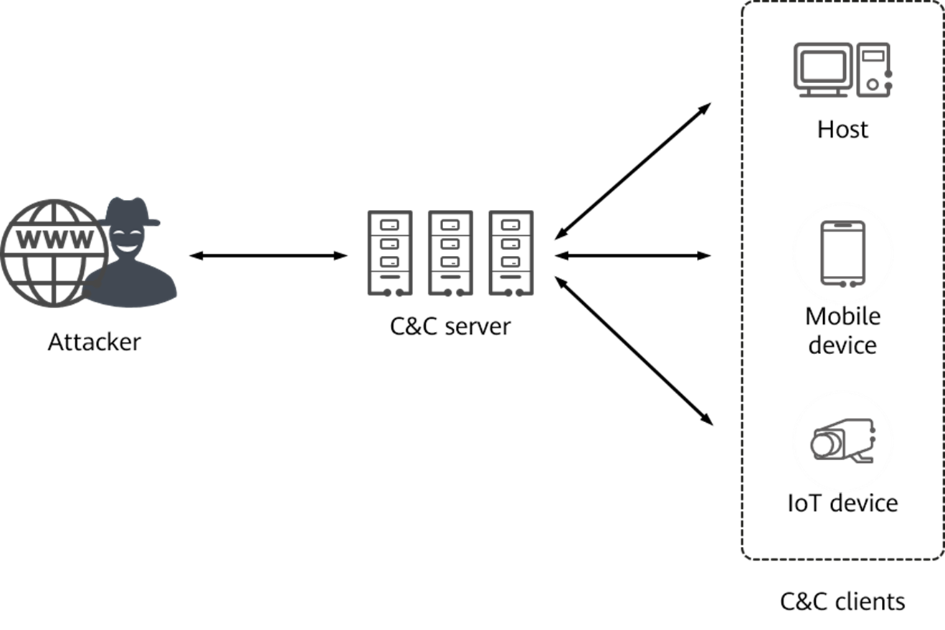

Slide 6

C2 Communication Channels
Cobalt Strike – HTTP(S), DNS, SMB
Uses “malleable” profile to shape traffic
Sliver – HTTP(S), mTLS, WireGuard, DNS
Procedurally generated HTTP traffic with randomized URLs and query arguments
Traffic is encrypted
Havoc – HTTP(S)
Able to shape HTTP traffic to a lesser extent

Slide 7
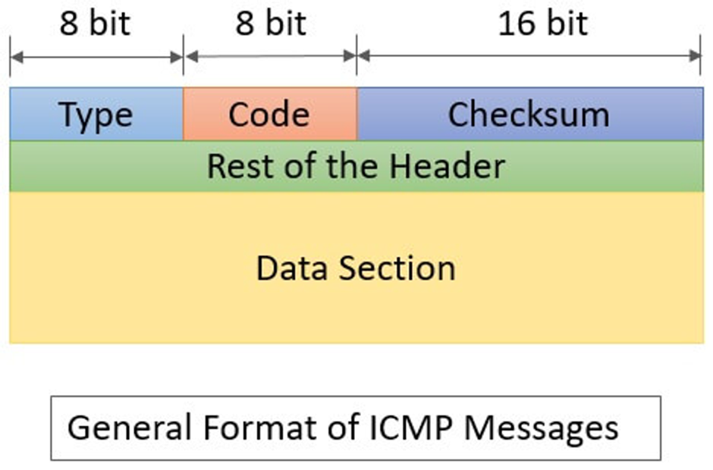
ICMP Primer
Operates at Network layer (3)
Used for sending operational information and error messages related to IP packet processing.
Type
0 – 255
Information about the message type
Code
0 – 255
Status information about the message

Slide 8
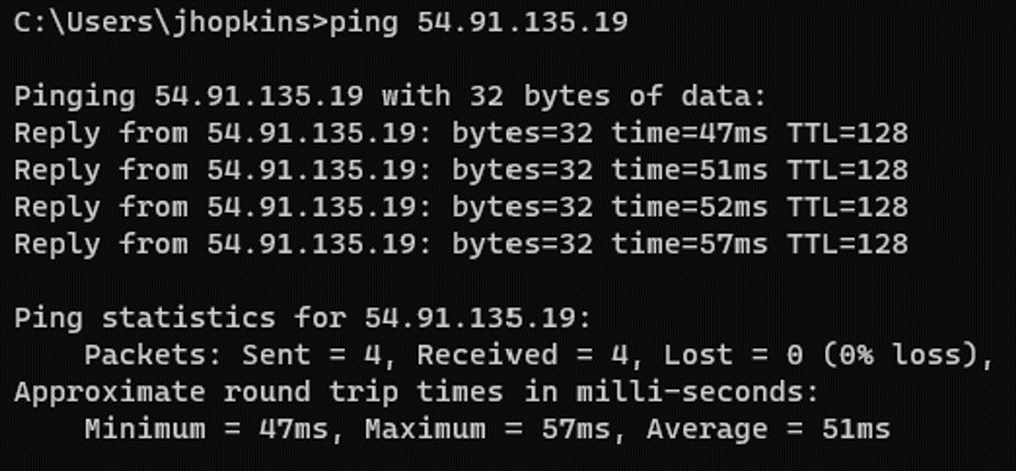
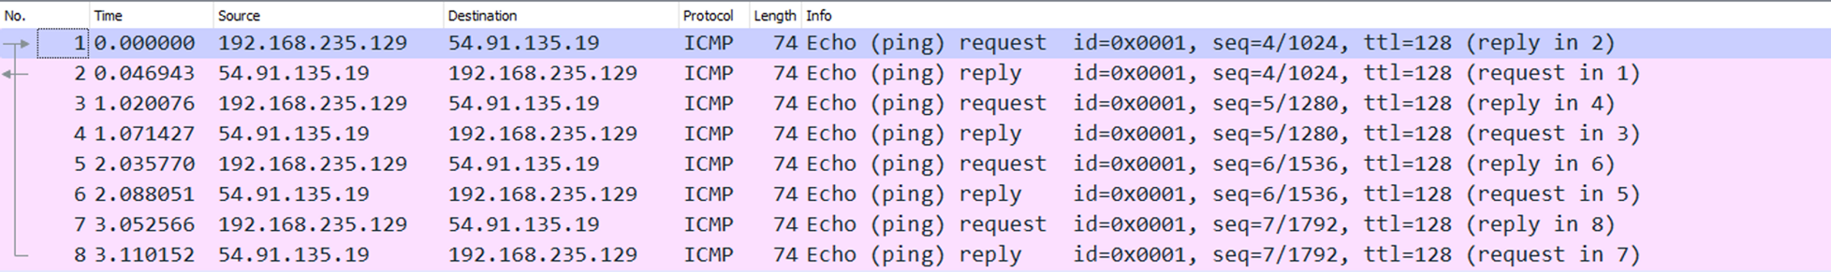

Slide 9
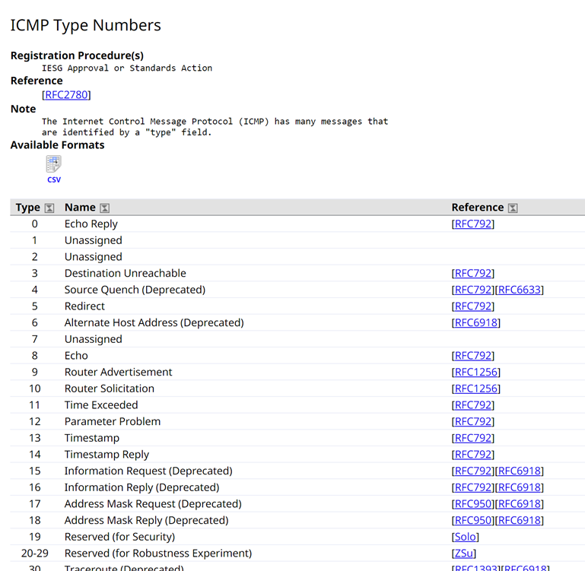
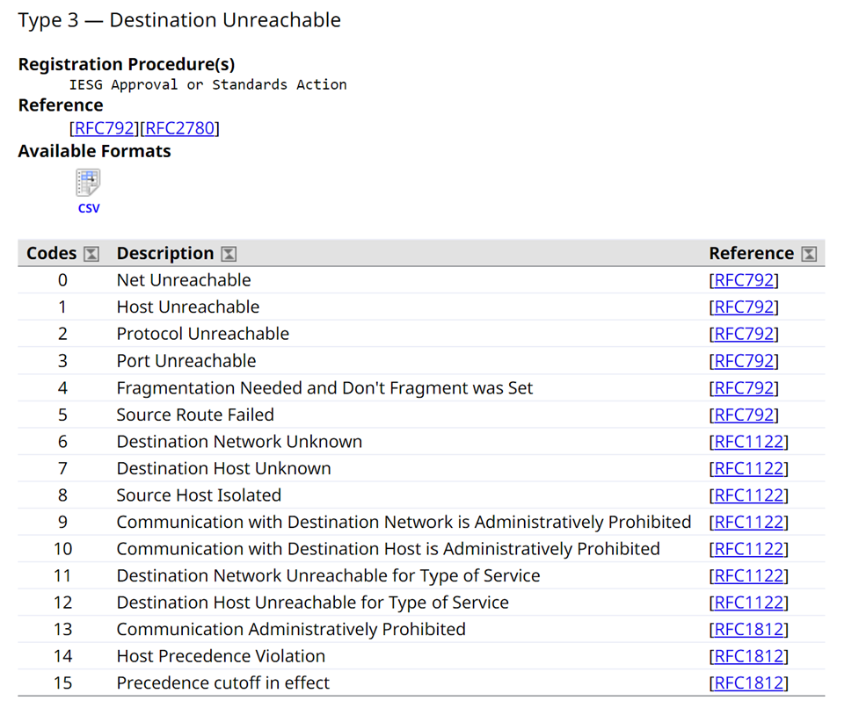

Slide 10
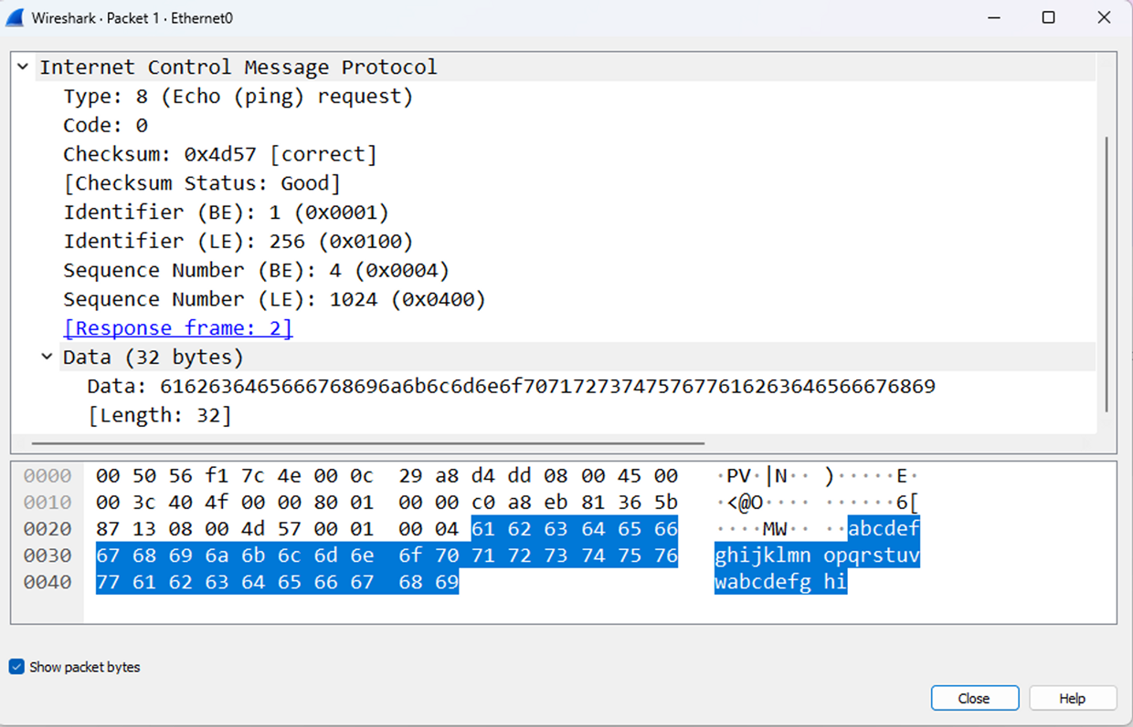
Type 8 Echo Request

Slide 11
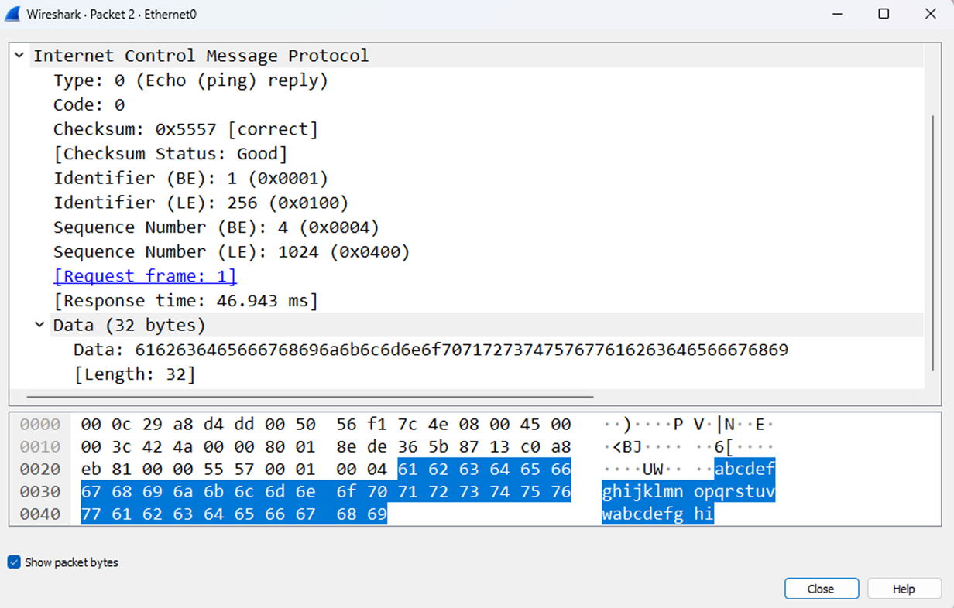
Type 0 Echo Reply

Slide 12

Why Rust for Offensive Development?
As fast or faster than C/C++
Strict compiler that guarantees memory-safety
Easy to cross compile
Excellent package management with Cargo
LLVM based which is great for evasion
Complex compiler which makes reverse engineering Rust binaries very difficult
Full support for Win32 API
Excellent at AV and EDR evasion

Slide 13

Some Cool Tools
Freeze.rs - https://github.com/optiv/Freeze.rs
Payload creation tool for bypassing EDR
Rootkit-rs - https://github.com/memN0ps/rootkit-rs
Windows rootkit
RustHound - https://github.com/OPENCYBER-FR/RustHound
Active Directory data collector for BloodHound
OffensiveRust - https://github.com/trickster0/OffensiveRust
Collection of different code examples for offensive operations
EarlyBird-rs
SynerComm malware dropper for C2

Slide 14

Let’s build our own “Ping” tool in less than 40 lines of Rust!

Slide 15
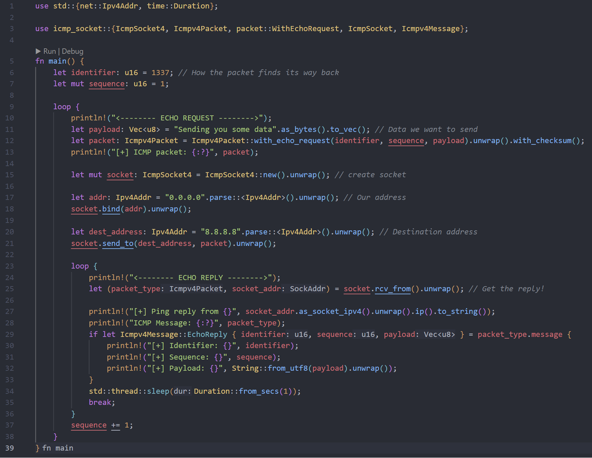

Slide 16
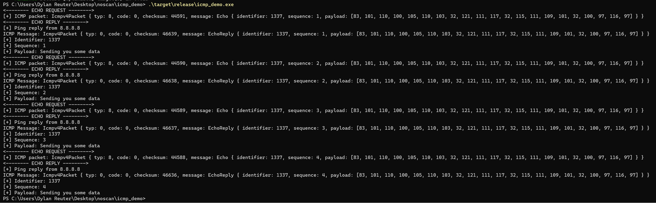

Slide 17
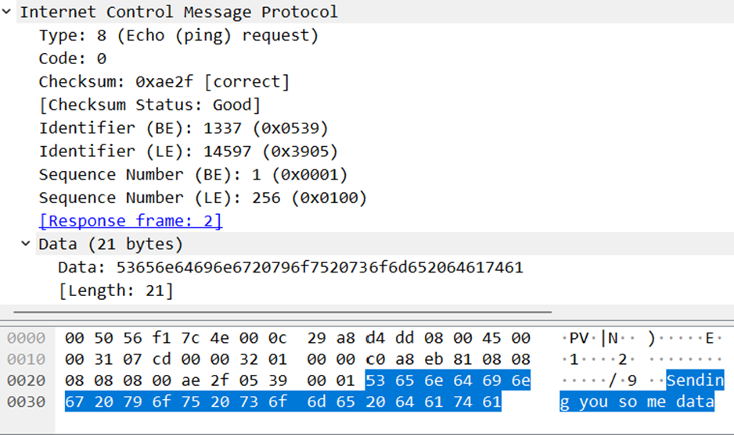
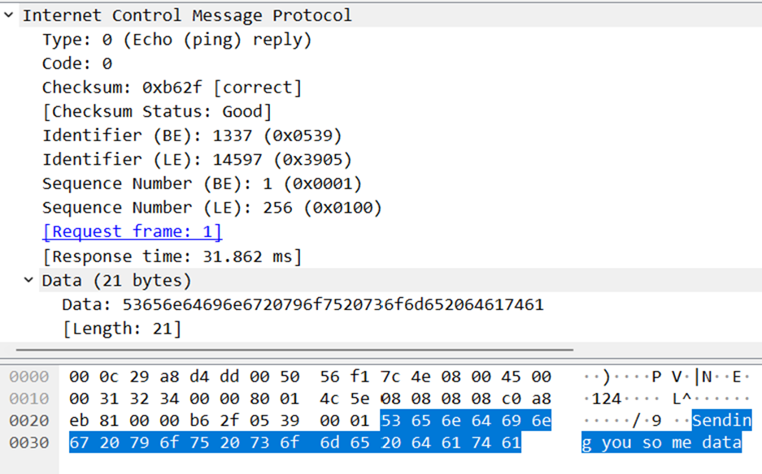
Echo Request
Echo Reply

Slide 18
Echo C2
Echo Reply’s are typically handled by the kernel
EchoC2 uses a custom ICMP client and server for full control over the exchange
Receives “tasks” from the server by sending a “ping”
Resulting data is sent out to a web server via HTTPS POST request

Slide 19

Features
HTTP server can be changed on the fly
Execute commands and .NET assemblies
User / Group and LDAP enumeration
Download / Upload files
Run a SOCKS4 proxy
Steal passwords
Take screenshots

Slide 20
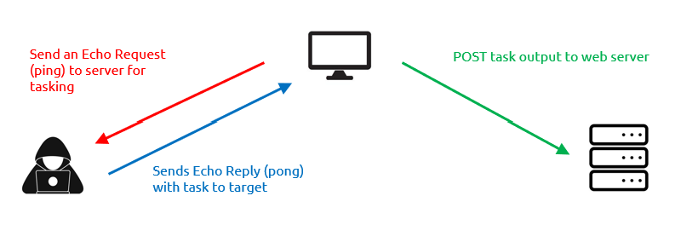
Communication Flow

Slide 21


Slide 22
Thank you!
https://github.com/djackreuter/developing_an_evasive_c2_agent
https://twitter.com/DylanReuter4
https://www.synercomm.com/blog/

